Slide 1
American Sign Language
corpus generation
Real-time Gesture Mapping And Recording
From Human To Avatar
Computer Graphics: CAP-4710/5701-U01
Final Project Presentation
Thursday, April 24, 2014
Student: Md Shakil Ahamed
Instructor: Dr. Wei Zeng
Florida International University
Notes:
Printed on Thursday, April 24, 2014 at 12:14 PM.

Slide 2
Review
Introduction
Motivation
Problem Statement
Concept of Work
Required Devices and Tools
Pipeline
Methodologies
Results
Video demo, output file
Future work
Summary

Slide 3

Introduction American Sign Language (ASL)

Slide 4
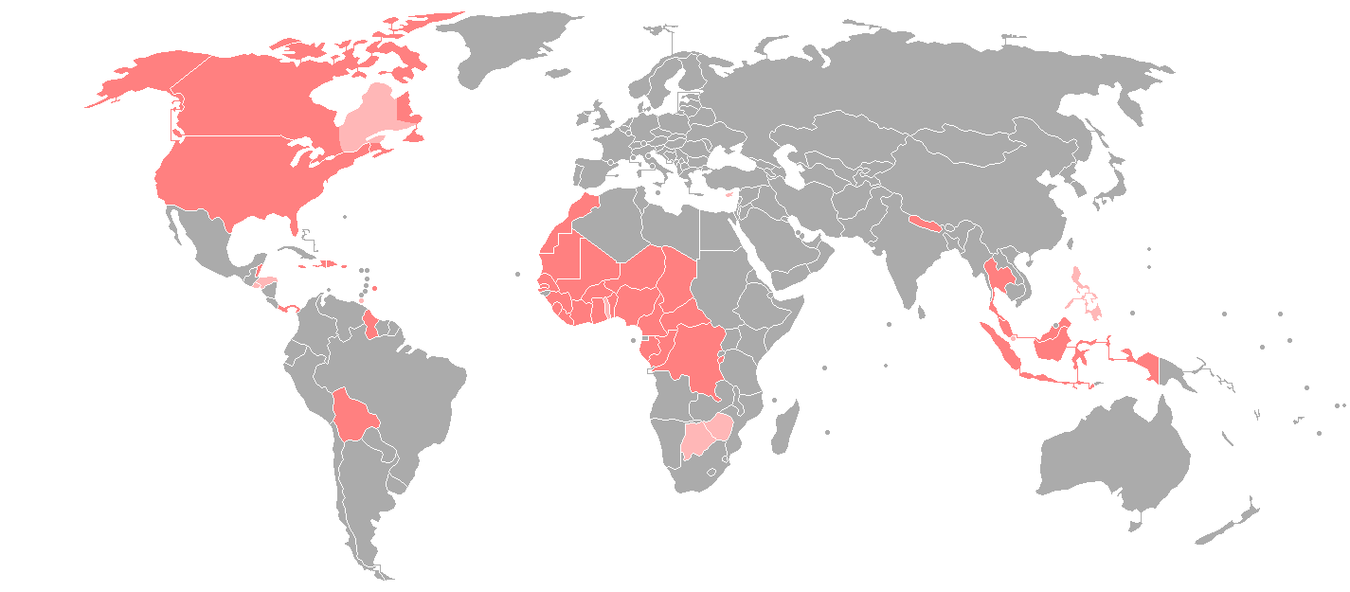
Introduction American Sign Language (ASL)
American Sign Language
Region | North America, West Africa, Central Africa
Native Speaker | 250,000-500,000 in the US (1972)
Language Family | French sign language
Origin | 19th Century, Connecticut
Source | [Mitchell, et al, 2006].
Areas of significant ASL users
Areas of national ASL users

Slide 5
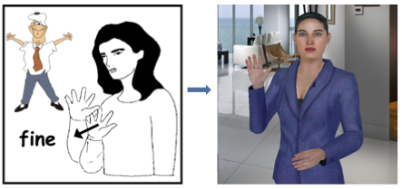
Introduction Motivation
Target Problem: Automatic ASL Translation Engine in Virtual Character

Slide 6
Introduction Problem Statement
Key problem? ASL corpus generation.
What is Corpus? Corpus is the building block of ASL signs.
Why? Corpus will be used for ASL sign animation

Slide 7

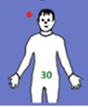


Introduction Concepts
ASL Corpus and origin?
Sign is generated using 4 components [Stokoe, 1960] shown in figures.
Virtual Character can produce the components as codes!
Record the codes and use those codes synchronously for ASL animation generation.
Any Issues?
Devices calibration
Proper use of recorded data for sign generation
Direction
Location
Shape
Orientation
Courtesy: Figures are from Institute of for Disabilities Research and Training Inc.

Slide 8
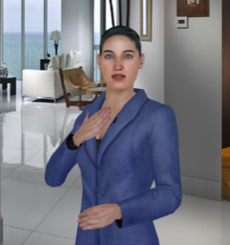

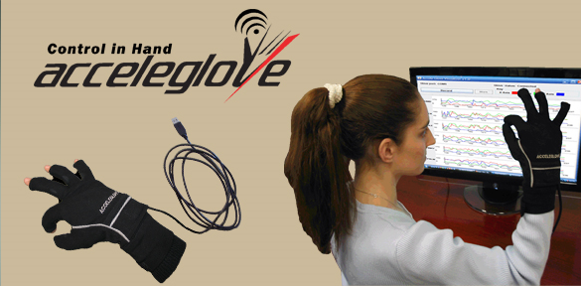
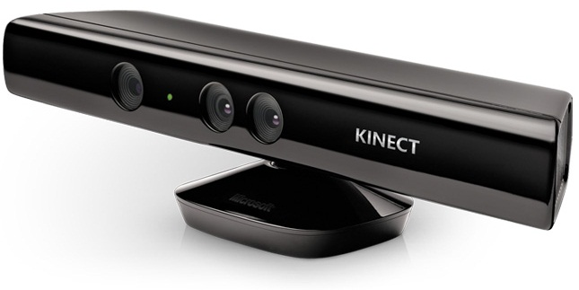
Introduction Devices and Tools
Haptek Avatar
Visual Studio
Hand Glove
Kinect Camera

Slide 9
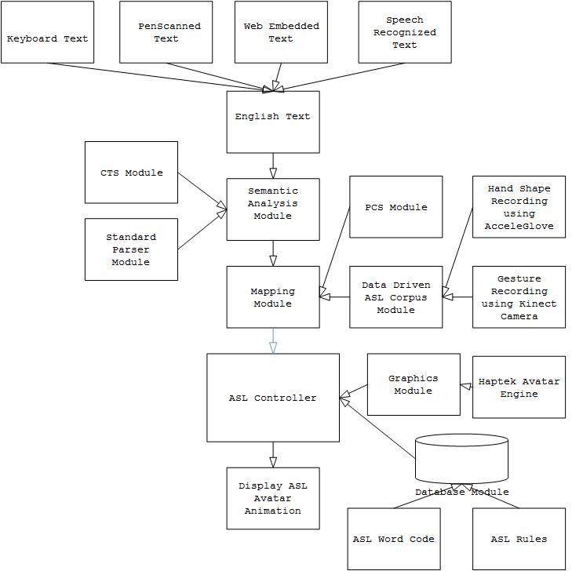
Pipeline Methodologies

Slide 10
Pipeline Methodologies
Data driven ASL corpus module
Shape and palm orientation Recording using Hand Glove …….(1)
Locaiton and direction of movement recording using Kinect …..(2)
Device settings for recording
Acceleglove
Map the input signals of each fingers, wrist of both hands with the Haptek virtual character
If required do calibration
Kinect
Map kinect detected shoulder, body skeleton with the Haptek soldier body registers
If required do calibration

Slide 11
Pipeline Methodologies
Recording
For (1) work:
(experiment phase) use human video and images (from IDRT) and record shape and palm orientation codes.
For (2) work:
(experiment phase) use human video and images and record location and direction of movement.
Both Kinect and Glove recording performed in microsoft dotnet platform.
Recording perform in .C# project space and data is writtten in a text file
Finally text data is converted into Haptek character compatible file

Slide 12
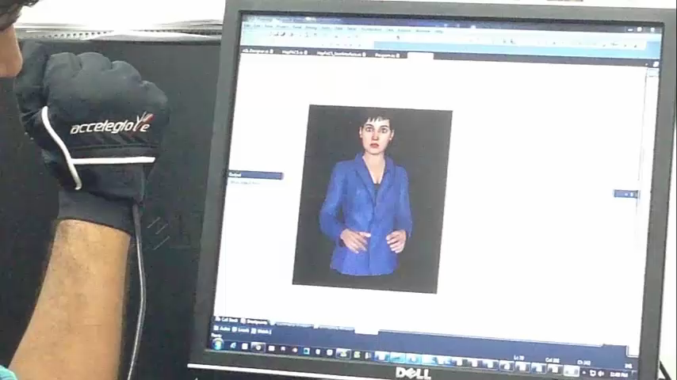
Current Progress Hand glove settings

Slide 13
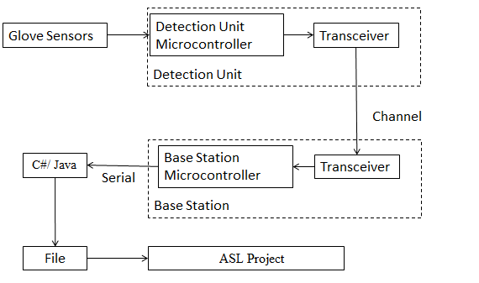
Current Progress Hand glove settings

Slide 14
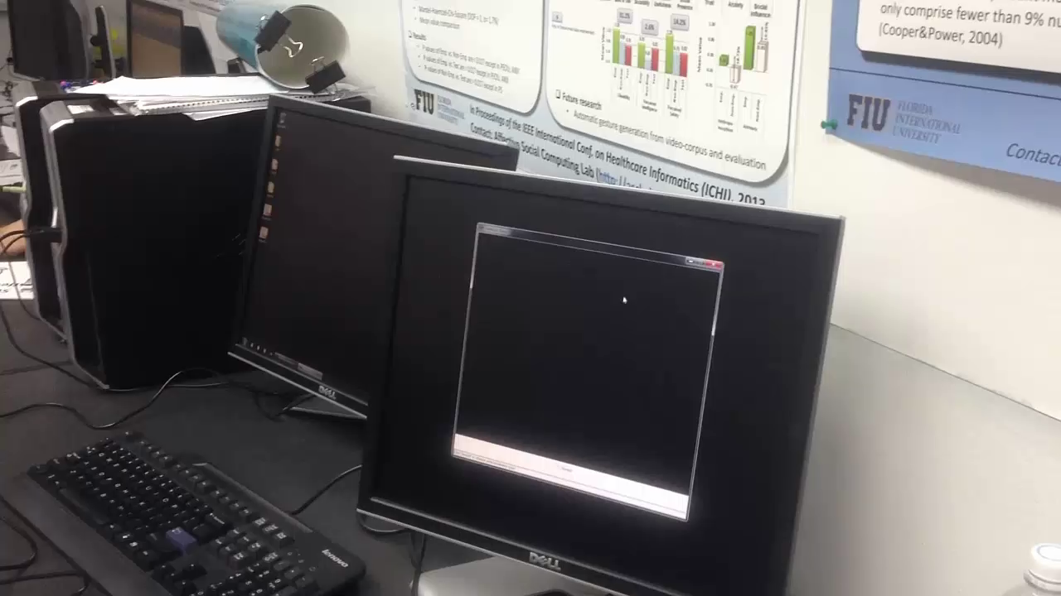
Current Progress Kinect settings

Slide 15
Current Progress Kinect settings

Slide 16
Current Progress Recorded File
"#Haptek Version= 2.00 Name= C:/ToPaste.txt HapType= script FileType= text
\clock [t= 2] \SetSwitch[switch= RHS28 state= a]
\clock [t= 2] \SetSwitch[switch= RHL27 state= a]
\clock [t= 2] \SetSwitch[switch= RHD13 state= a]
\clock [t= 2] \SetSwitch[switch= RHO1 state= a]
"
\clock [t= 2] \SetSwitch[switch= RHS28 state= a]
\clock [t= 2] \SetSwitch[switch= RHL27 state= a]
\clock [t= 2] \SetSwitch[switch= RHD13 state= a]
\clock [t= 2] \SetSwitch[switch= RHO1 state= a]
"
Switch is a combination of registers whose are based on state machine principle

Slide 17
Current Limitation
Hand Glove
Middle finger of current glove shows distortion problem
We have another glove which is from different company, wish to use.
Kinect
We got skeleton but did not map the skeleton with the Haptek character.

Slide 18
Future Goal Next plan
Good Recording
ASL corpus database
Compare our database with existing ASL corpus database

Slide 19
Summary
We integrated virtual character in ASL corpus generation
Glove used for shape and orientation recording
Kinect used for location and direction recording
We want to use this data for automatic ASL translation engine.

Slide 20
References
[1] K Mulrooney, “American Sign Language DeMystified”, Book.
[2] Pengfei Lua, Matt Huenerfauth, “Collecting and evaluating the CUNY
ASLcorpus for research on American Sign Language animation”,ScienceDirect,
Computer Speech and Language 28 (2014) 812–831.
[3] “Haptek Automated Personalities Programmer’s Technical White Paper”,
Haptek Inc.
[4] Huenerfauth M. and Lu P., "Accurate and Accessible Motion-Capture Glove
Calibration for Sign Language Data Collection", ACM Transactions on
Accessible Computing (TACCESS), Volume 3 Issue 1, September 2010,
New York, NY, USA.

Slide 21
Thank you

